Slide 1
Bayesian Information Recovery from CNN for Probabilistic Inference
Jan 20, 2019
Authors: Dmitry Kopitkov & Vadim Indelman
Presented by: Daniel Engelsman & Itai Zilberman

Slide 2
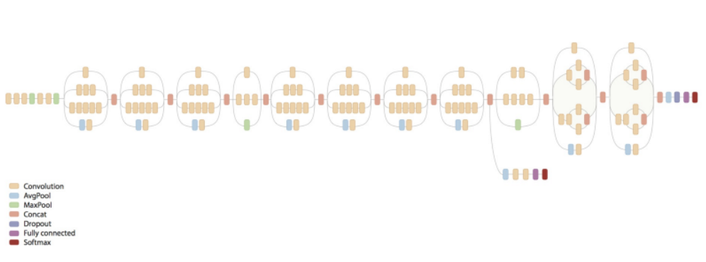
Abstract
This paper presents a novel approach to infer system hidden state from visual observation, via CNN features which are outputs of a CNN classifier.
Inception v3

Slide 3
Agenda
Introduction
Prob. formulation
Approach
Results
Summary

Slide 4
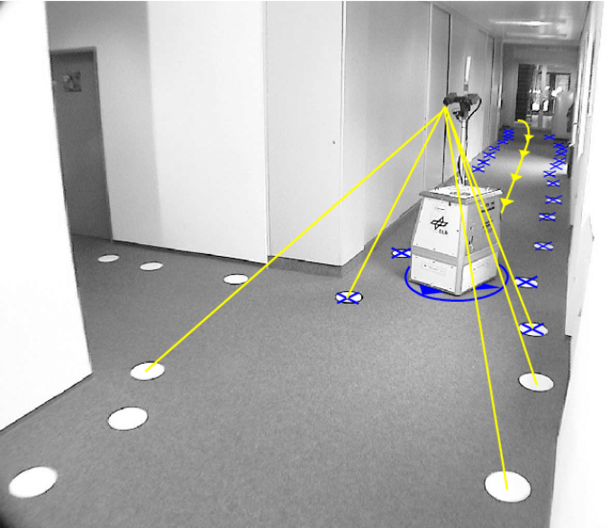

Introduction
Inferring a system state from multiple measurements, is a fundamental problem in robotics.
The above may become very challenging when the measurements are high-dimensional (e.g. images).
Intro
formulation
Approach
Results
Summary
Notes:
convergence of factor graph SLAM algorithms relies heavily on correct data association of the landmarks. Even a single false association can cause the algorithm to diverge

Slide 5
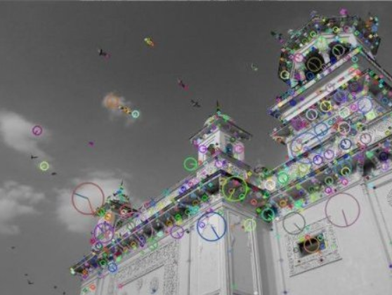
Introduction
A common approach to deal with images is by producing
from them visual features (as in “SIFT”).
One can utilize this features to localize
the robot pose, via triangulation and multi-view geometry.
Intro
formulation
Approach
Results
Summary
Notes:
convergence of factor graph SLAM algorithms relies heavily on correct data association of the landmarks. Even a single false association can cause the algorithm to diverge

Slide 6
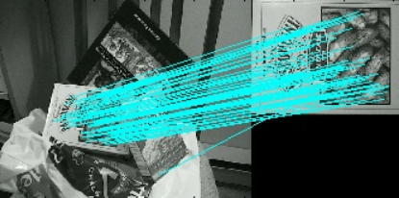
Introduction
However, such geometric methods have significant weaknesses:
The landmarks are not always robustly detected w.r.t. changing environment conditions.
Landmark-based techniques require determining data
association. This process is tough and prone to mistakes.
Intro
formulation
Approach
Results
Summary
Notes:
convergence of factor graph SLAM algorithms relies heavily on correct data association of the landmarks. Even a single false association can cause the algorithm to diverge

Slide 7
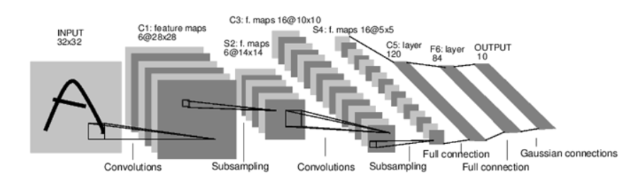
Introduction
This paper presents an alternative approach that instead uses
short descriptors of images produced by a convolutional neural network (CNN).
This descriptors known as “feature vectors”.
Intro
formulation
“Feature vector”
Approach
Results
Summary
Notes:
convergence of factor graph SLAM algorithms relies heavily on correct data association of the landmarks. Even a single false association can cause the algorithm to diverge

Slide 8
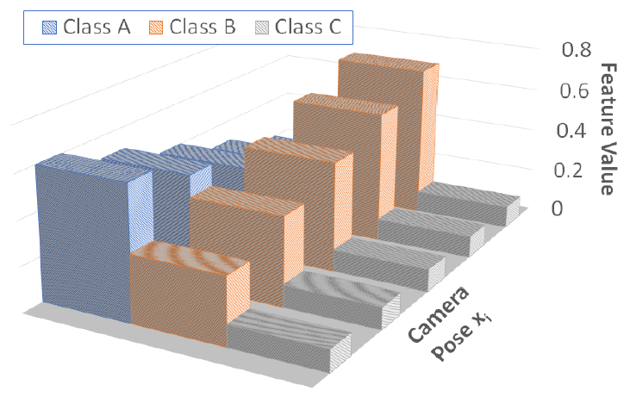
Introduction
These “feature vectors” are viewpoint-dependent.
Thus, we can perform robot localization by utilizing this information.
Intro
formulation
Approach
Results
Summary
Notes:
convergence of factor graph SLAM algorithms relies heavily on correct data association of the landmarks. Even a single false association can cause the algorithm to diverge

Slide 9

Problem formulation
Definitions:
$x_{i}$ - The robot pose at time step $i$.
$X_{k}=\{x_{0},x_{1},…, x_{k}\}$ - Accumulative pose vector (trajectory) until current time k.
$f^{j}\left(X_{j}\right)$ - Factor $j$ (represents a measurement model), involving positions up to time $j$.
Intro
formulation
Approach
Results
Summary

Slide 10


Problem formulation
The probability density function (pdf) of $X_{k}$ can be represented as:
$$P\left(X_{k} | history\right)∝ \prod_{j=1}^{n_{f}}{f^{j}\left(X^{j}\right)}=\prod_{j=1}^{n_{f}}{{\det\left(2πΣ^{j}\right)}^{−\frac{1}{2}}∙\exp\left(−\frac{1}{2}{\left|\left|h^{j}\left(X^{j}, z^{j}\right)\right|\right|}_{Σ^{j}}^{2}\right)}$$
The MAP estimation of trajectory $X_{k}$ can be calculated by:
$$X_{k}^{∗}= argmin_{X_{k}}\left(\sum_{j=1}^{n_{f}}{\log\left(\det\left(Σ^{j}\right)\right)+ \sum_{j=1}^{n_{f}}{{\left|\left|h^{j}\left(X^{j}, z^{j}\right)\right|\right|}_{Σ^{j}}^{2}}}\right)$$
Intro
But who is $h^{j}(X^{j}, z^{j})$?
formulation
Approach
Results
Summary

Slide 11

Problem formulation
Our measurement model will be$P(f_{i}|x_{i})$ where $f_{i}$is the feature vector mentioned before.
Meaning, $h^{j}(X^{j}, z^{j})$ is related somehow to $P(f_{i},|x_{i})$.
How can we find $P(f_{i}|x_{i})$?
How can we fit it in the Bayesian inference terms?
We will see how next in the approach session.
Intro
formulation
Approach
Results
Summary

Slide 12
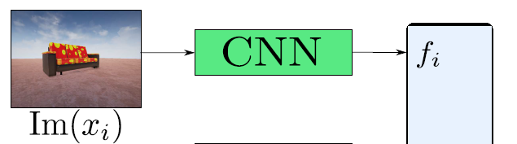

Approach
As we implied before, we are willing to exploit CCN’s feature vectors and their view-point dependency, and develop a corresponding Bayesian inference formulation.
In order to learning their behavior as a function of robot pose x, meaning, $P(f|x)$, we use pre-trained Inception v-3 CNN.
At each time step $i$ and given an image captured $z_{i}$, the CNN provide us a feature vector $f_{i}$.
Intro
formulation
Approach
Results
Summary

Slide 13
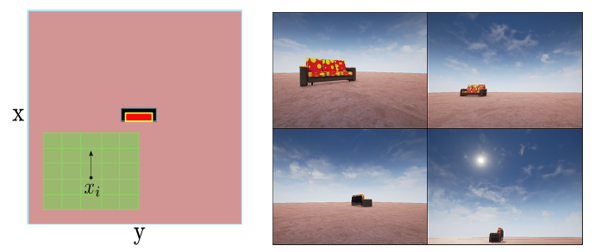

Approach - Measurement Model Learning via DL
Our goal is to learn $P\left(f | x\right).$
We will assume it is Gaussian, thus, our learning objectives are: $μ\left(x\right), Σ(x)$.
To that end, we sample a dataset $D=\left\{x_{i}, f_{i}\right\}$, containing $200,000$ pairs of positions $x_{i}$ and their corresponding feature vectors $f_{i}$.
Where pose $x_{i}$ is taken uniformly from the
scenario’s environment and where $f_{i}$ is a
CNN feature vector provided for image
captured at pose $x_{i}$.
Intro
formulation
Approach
Results
Summary

Slide 14
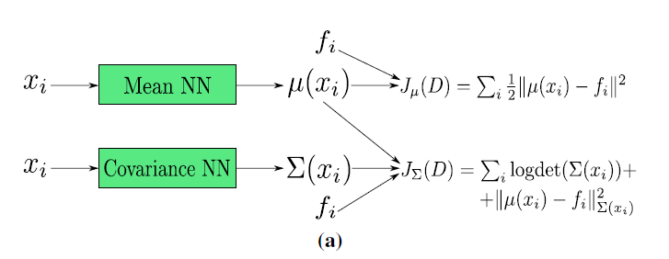

Approach - Measurement Model Learning via DL
We use two separate networks (both have a similar architecture) to learn $μ(x_{i})$ and $Σ(x_{i})$, the mean and the covariance of the distribution $P\left(f_{i} | x_{i}\right).$
Intro
formulation
Approach
Results
Summary

Slide 15

Approach - Measurement Model Learning via DL
First, we train the mean network with an L2 regression loss:
$$μ\left(x\right)=argmin_{θ_{μ}}\left(J_{μ}\left(D\right)\right)=argmin_{θ_{μ}}\left(\sum_{i}{\frac{1}{2}{\left|\left|μ\left(x_{i}\right)−f_{i}\right|\right|}_{2}^{2}}\right)$$
Intro
formulation
Approach
Results
Summary

Slide 16

Approach - Measurement Model Learning via DL
After the training converges, we use it for the covariance
network learning through a maximum likelihood loss:
$$Σ\left(x\right)=argmax_{θ_{Σ}}\left(\prod_{i}{P\left(f_{i} | x_{i}\right)}\right)=argmin_{θ_{Σ}}\left(J_{Σ}\left(D\right)\right)$$
$$=argmin_{θ_{Σ}}\left(\sum_{i}{logdet\left(Σ\left(x_{i}\right)\right)+{\left|\left|μ\left(x_{i}\right)−f_{i}\right|\right|}_{Σ\left(x_{i}\right)}^{2}}\right)$$
Intro
formulation
Approach
Results
Summary

Slide 17
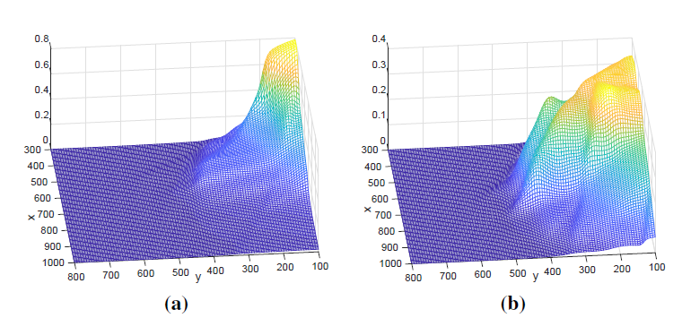

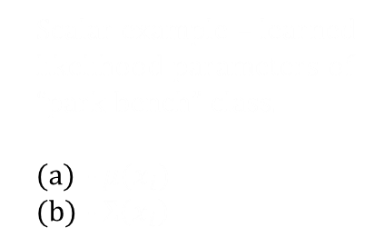

Approach - MAP Inference via Spatially-Varying Models
Scalar example – learned likelihood parameters of “park bench” class.
- $μ(x_{i})$
- $Σ\left(x_{i}\right)$
After learning $μ(x_{i})$ and $Σ(x_{i})$, the CNN factor can be represented as:
$$P\left(f_{i} | x_{i}\right)={\det\left(2πΣ\left(x_{i}\right)\right)}^{−\frac{1}{2}}∙\exp\left(−\frac{1}{2}{\left|\left|μ\left(x_{i}\right)−f_{i}\right|\right|}_{Σ\left(x_{i}\right)}^{2}\right)$$
Intro
formulation
Note that $Σ\left(x_{i}\right)$ is state-dependent, in contrast to the usual setting in SLAM,
which typically considers both terms to be constant.
Approach
Results
Summary

Slide 18

Approach - MAP Inference via Spatially-Varying Models
The above factor will introduce two terms into the MAP Inference:
$$X_{k}^{∗}=argmin_{X_{k}}\left(…+logdet\left(Σ\left(x_{i}\right)\right)+{\left|\left|f_{i}−μ\left(x_{i}\right)\right|\right|}_{Σ\left(x_{i}\right)}^{2}\right)$$
The above Bayesian optimization can be efficiently solved using
incremental Gauss-Newton, given that it has a least-squares
Form ($logdet\left(Σ\left(x_{i}\right)\right)$ is negligible).
Intro
formulation
Approach
Results
Summary

Slide 19
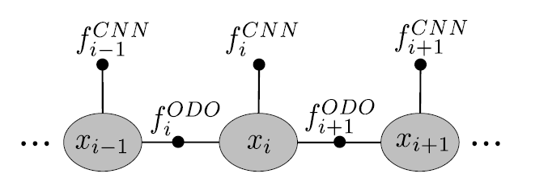

Approach - summary
$$X_{k}^{∗}= argmin_{X_{k}}\left(\sum_{j=1}^{n_{f}}{\log\left(\det\left(Σ^{j}(x_{j})\right)\right)+ \sum_{j=1}^{n_{f}}{{\left|\left|f_{j}−μ(x_{j})\right|\right|}_{Σ^{j}}^{2}}}\right)$$
The total trajectory inference is illustrated in the above factor graph.
There are 2 types of factors: odometry & CNN feature vectors.
The PDF function for the CNN-factors, $P(f_{i}|x_{i})$, was assumed to be Gaussian, and its parameters, $μ(x_{i})$ and $Σ(x_{i})$, were studied by the CNN.
Intro
formulation
Approach
Results
Summary

Slide 20
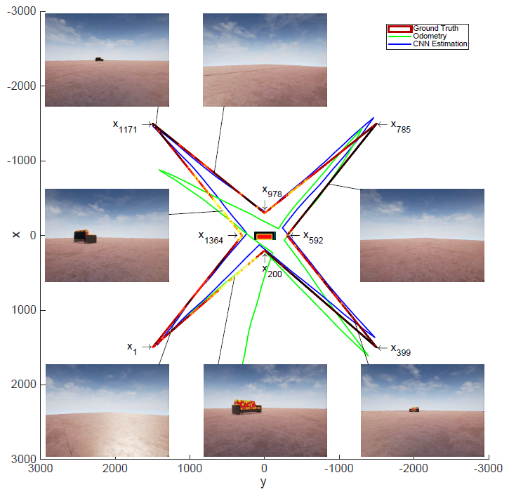
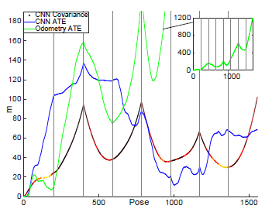
Results
Intro
formulation
Approach
Results
Summary

Slide 21
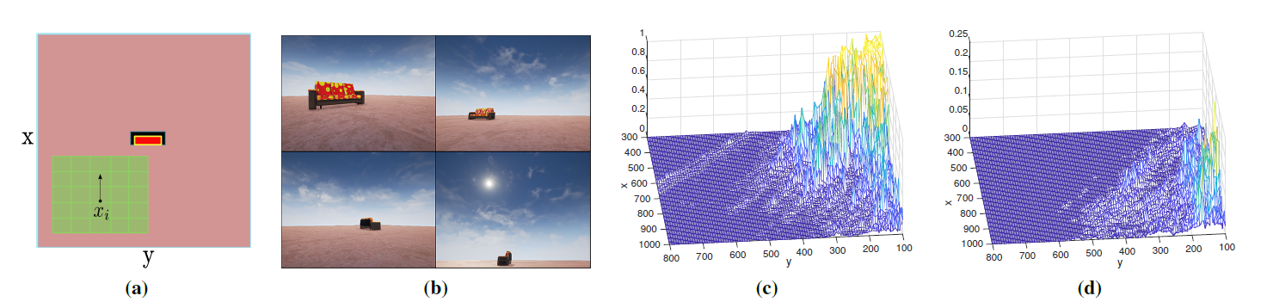

Approach – Unimodal vs multimodal
Moreover,
According to the paper such feature distribution $P(f_{i}|x_{i})$ conditioned
on a position x will have only a single mode - given
a specific position, the CNN feature (e.g. probability to see a
chair in the captured image) will be spread around a specific
single value. This can be seen empirically
Intro
formulation
Approach
Results
Summary

Slide 22
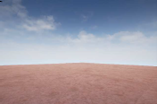
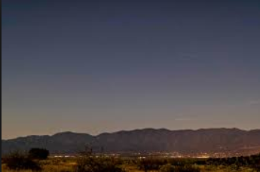
Results – lights condition effect
In order to examine robustness of the suggested approach to different
light conditions, two types of illumination were tested:
Bright illumination dark illumination
Intro
formulation
Approach
Results
Summary

Slide 23
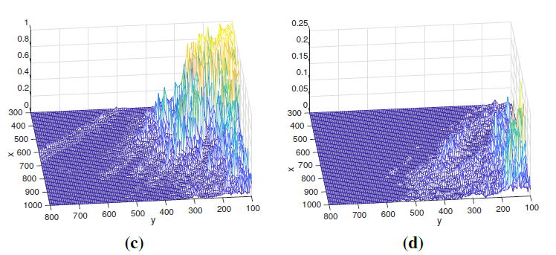
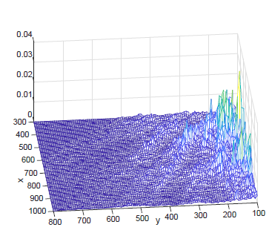
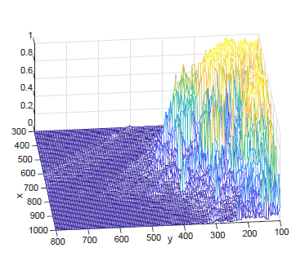
Results – lights condition effect
As it turned out, the feature vectors behaving differently:
Bright illumination dark illumination
Intro
formulation
“park bench” class
“rocking chair” class
“rocking chair” class
“park bench” class
Approach
Results
Summary

Slide 24

Results – lights condition effect
As it turned out, the feature vectors behaving differently:
In other words, CNN feature vectors are not robust to different light conditions.
The inference task in dark environment produced estimation that was
only a little better than odometry drift.
This is not entirely surprising, since the CNN trained on “bright skies data” only.
Intro
formulation
Approach
Results
Summary

Slide 25
Summary - conclusions
CNN features are highly viewpoint-dependent.
their generative model can be successfully learned via neural network.
such model can be used to localize robot trajectory as Gaussian factor in Bayesian estimation.
Intro
formulation
Approach
Results
Summary

Slide 26
Summary - strengths
The suggested approach does not require to solve the challenging data association problem (Efficiency)
Easy inference process (learned pdf is unimodal).
Unlike many related works, here uncertainty estimation is not been ignored.
Robustness to classifier quality.
Intro
formulation
Approach
Results
Summary

Slide 27
Summary - weaknesses
Environment has to be Known.
The approach was tested on a very simple (and not realistic) environment.
The environment Is simulated using unreal Engine (Images samples are deterministic).
Gaussian distribution assumption.
Lake of robustness to different light conditions.
Intro
formulation
Approach
Results
Summary

Slide 28

Any Questions?

